Slide 1

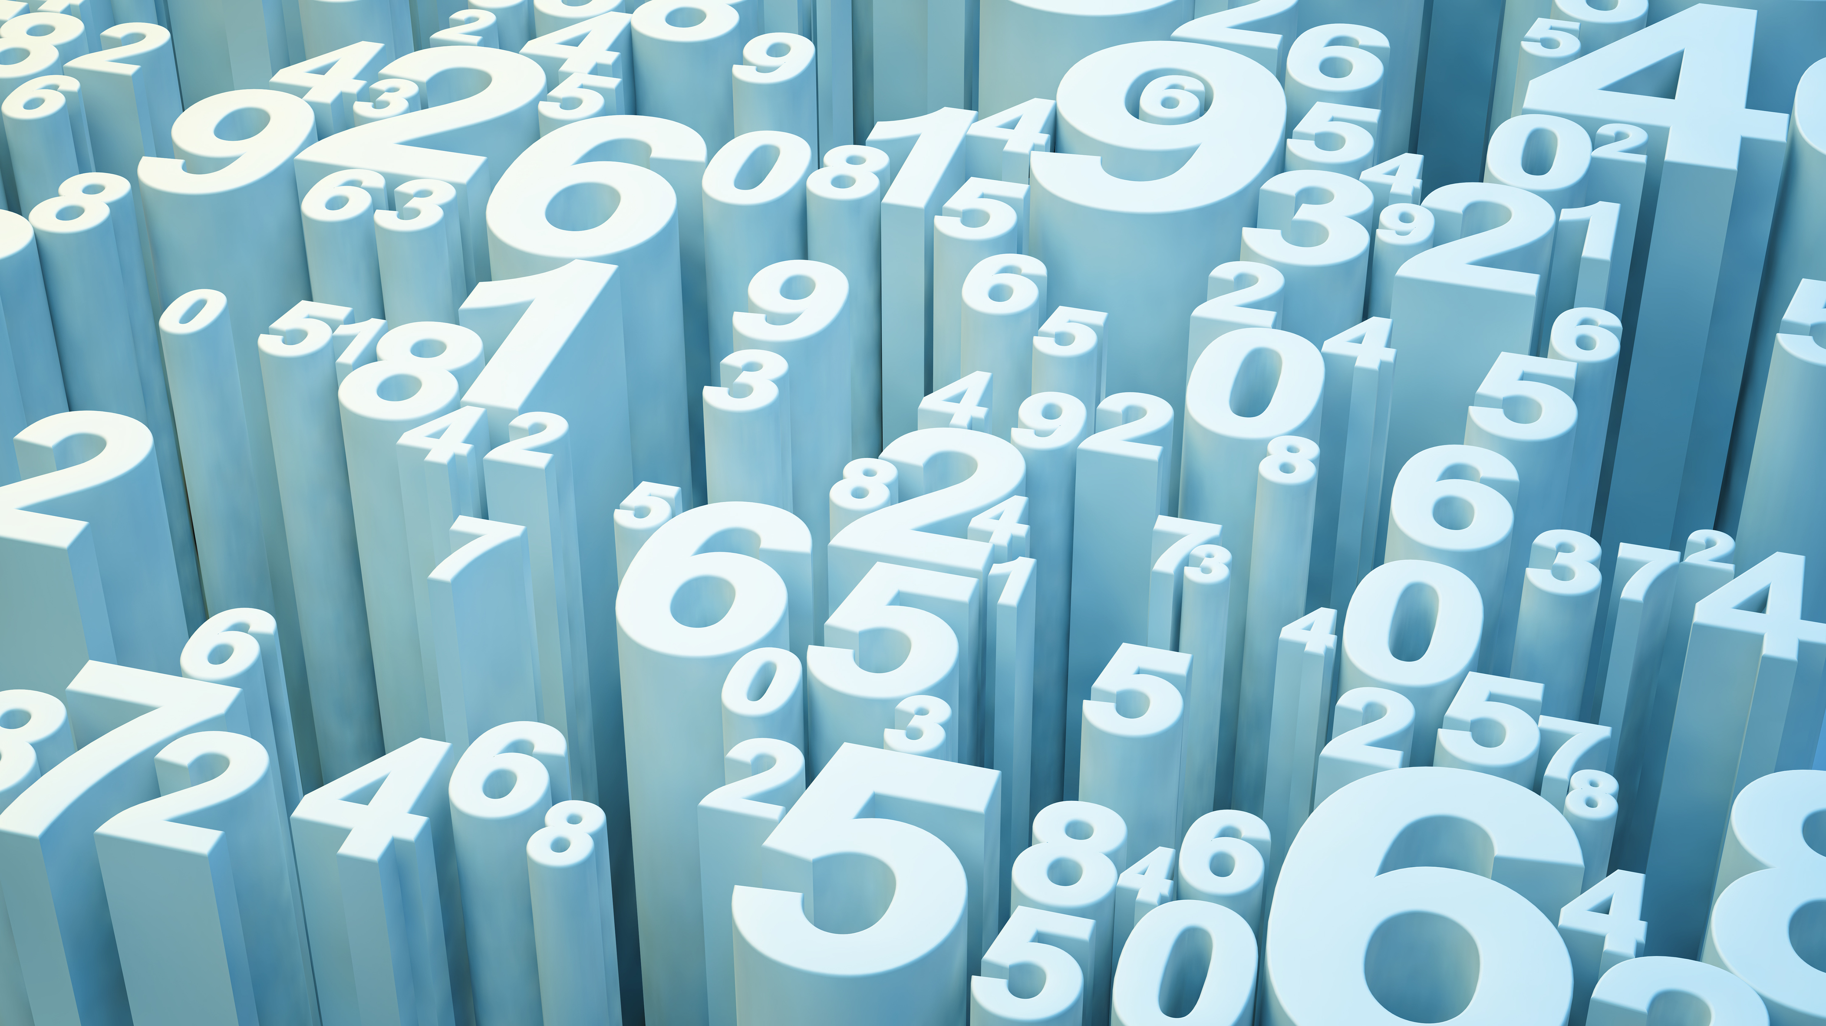
Parkinson’s Disease Detection
Group Members:
Rajat Gore (20BAI10184)
Shivam Kabra (20BAI10298)
Sahu (20BDivyanshAI10363)
Divyanshu Chetan (20BAI10129)
Guide: Dr Rajeev Goyal

Slide 2
What is Parkinson’s Disease?
Parkinson Disease is a brain neurological disorder. It leads to shaking of the body, hands and provides stiffness to the body. No proper cure or treatment is available yet at the advanced stage. Treatment is possible only when done at the early or onset of the disease. These will not only reduce the cost of the disease but will also possibly save a life.

Slide 3
Proposed Work & Methodology
We will use some machine learning algorithms like XGBoost, KNN, SVMs, and Random Forest Algorithm to check which is the best algorithm for detection of the onset of disease.

Slide 4
XG Boost Algorithm
XGBoost is a new Machine Learning algorithm designed with speed and performance in mind. XGBoost stands for eXtreme Gradient Boosting and is based on decision trees.
XGBoost set of rules is an implementation of gradient boosted choice timber.

Slide 5
KNN Algorithm
K-Nearest Neighbors (KNN ) algorithm, is one of the most powerful utilized algorithms of machine learning that is widely used both for regression as well as classification tasks. In order to predict and examine the class in which data points fall, it examines the label of chosen data points surrounded by the target point.

Slide 6
Support Vector Machines (SVMs)
It is a supervised machine algorithm used. Image classification and hand-written recognition are where the support vector machine comes to hand used. It sorts the data in one out of two categories and displays the output with the margin between the two as far as possible.

Slide 7
Random Forest Algorithm
Random forests are an ensemble version of many choice bushes, wherein each tree will specialize its focus on a specific feature while maintaining a top-level view of all capabilities.
Each tree within the random wooded area will do its own random train/check break up of the information, referred to as bootstrap aggregation and the samples no longer covered are called the ‘out-of-bag samples. Moreover, every tree will do characteristic bagging at every node-branch split to lessen the results of a characteristic mostly correlated with the response.
While an individual tree is probably touchy to outliers, the ensemble version will no longer be the same.

Slide 8
Novelty
Most methods available can detect Parkinson in an advanced stage; which means loss of approx.. 60% dopamine in basal ganglia and is responsible for controlling the movement of the body with a small amount of dopamine. More than 145,000 people have been found alone suffering in the U.K and in India, almost one million population suffers from this disease and it’s spreading fast in the entire world.

Slide 9
Real-time Usage
Parkinson’s disease affects the CNS of the brain and has yet no treatment unless it’s detected early. Late detection leads to no treatment and loss of life. Thus its early detection is significant. For early detection of the disease, we can utilize machine learning algorithms such as KNN, SVM and Random Forest.
These algorithms will predict the onset of the disease which will enable early treatment and save a life.

Slide 10
Hardware & Software Requirements
Computer ( latest gen processor, min 8gb ram and a gpu)
Jupyter Notebook
Libraries
scikit-learn, numpy, pandas, and xgboost,

Slide 11
THANK YOU

